Slide 1
Presentation: Kinase-substrate prediction using phosphoproteomics datasets
Presented by
Group 27 - Project 2 (STAT5003)
Ben Daly
Ken Pang
Sakthi Rajendran
Jun Xiong
Yuan Zhu

Slide 2
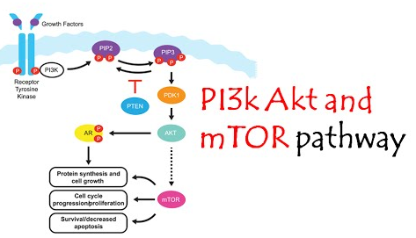
Introduction and Dataset
Aim:
Apply classification techniques for predicting novel kinase-substrates. Given a small set of positive labelled data
Data sets:
InsulinPhospho.txt (12,062 Observations and 16 features)
Akt Substrates (22 Observations) ~known samples
mTor Substrates (26 Observations) ~known samples
AUC_Ins.txt (12062 and 3 features) : AUC_Ins has no extra information, it is actually a subset of InsulinPhospho.txt
Fig 1: Protein Pathways
Source: https://www.youtube.com/watch?v=wO_D4dH7PI8
Positive Labelled data with critical data imbalance

Slide 3
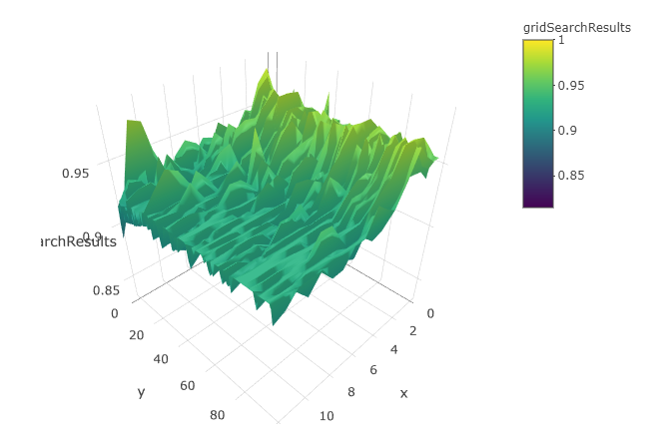
Approach
Data Preparation
Import datasets into R
Transform data to include labels and basic features
Check for missing values
Baseline Classification models
Build baseline classifiers
Utilise step-wise selection, grid search and cross validation to optimize each classifier for known labels
Apply AdaSampling to each optimized classifier for handling positive unlabeled data
Fig 2. 3D surface plot: mtry (x), ntrees (y) and accuracy (z)

Slide 4
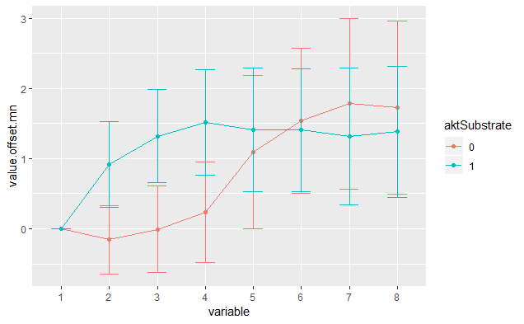
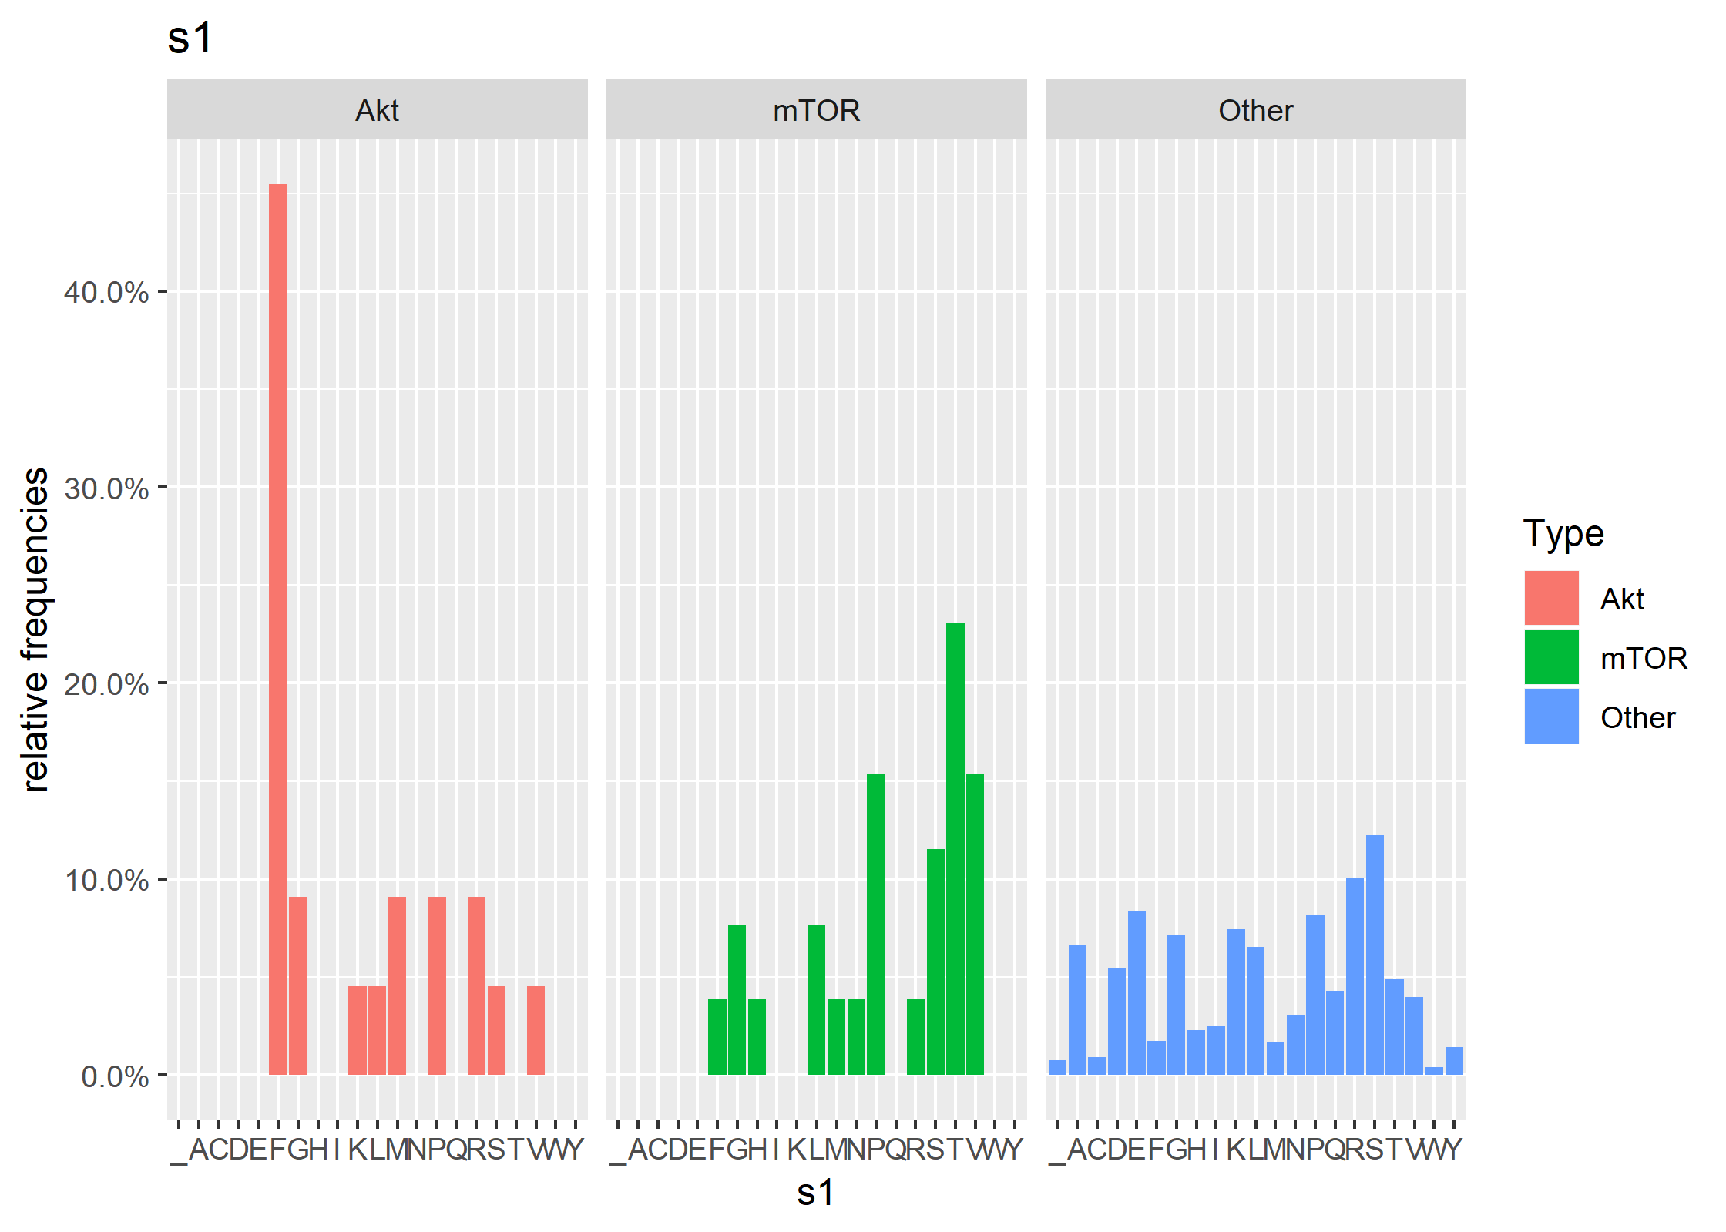
Approach
Feature Generation
Investigate if any patterns exist between Ins.1, LY, Ins.2, MK responses.
Generated various scatter plots between variables to observe feature relationships
Visualise sequence window to identify any patterns
Time and Sequence window features added
Feature Selection
Step wise feature selection methods for logistic regression
Logistic Regression model reveals that only AUC is the significant feature, others are not prominent
SVM feature selection did not improve the accuracy of the model.
Fig 3. Time series response curves Akt and mTOR using mean values
Fig 4. Column chart of sequence frequencies in position 1 of 13

Slide 5
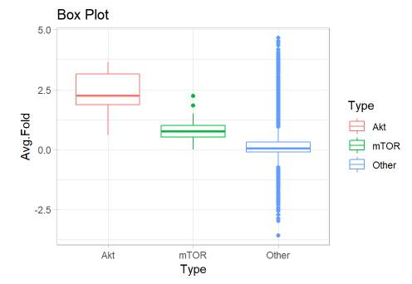
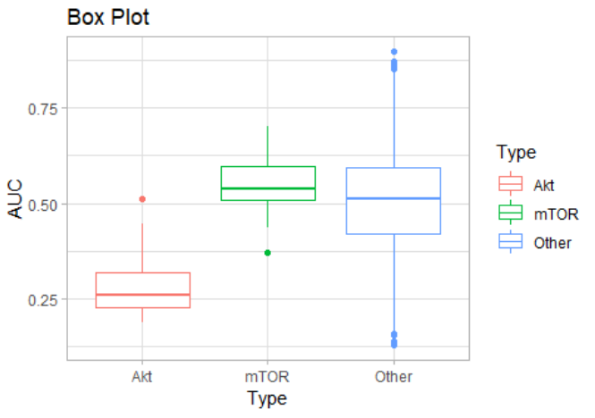
Feature Visualisation
Fig 5. Box plot for Avg. Fold by Substrate Type
Fig 6. Box plot for AUC by Substrate Type

Slide 6
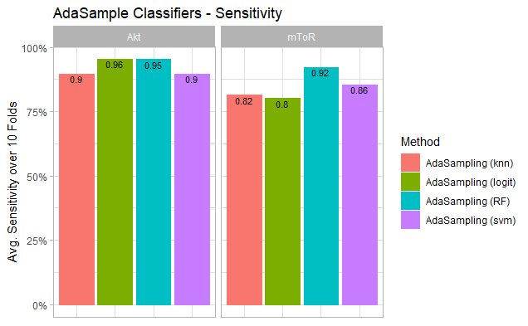
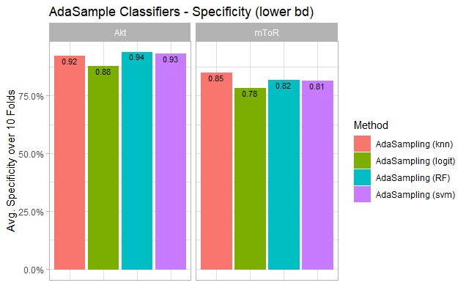
Classifier Results
Classification Models Compared
SVM
Logistic Regression
KNN
Random Forest
AdaSampling (applied to all 4 models)
Fig 7. Sensitivity (10 Fold CV) with AdaSample
Metrics:
Sensitivity
Specificity (lower bound)
RF performs best
Fig 8. Specificity (10 Fold CV) with AdaSample

Slide 7
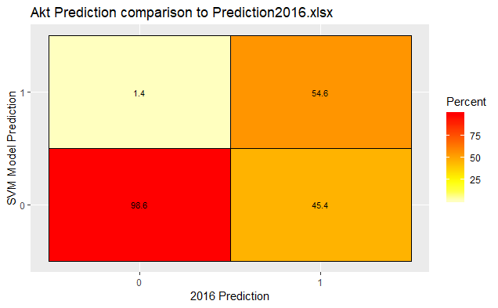
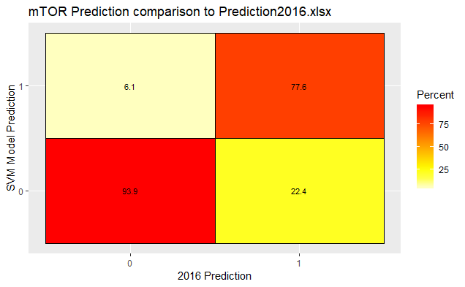
Comparison to prior experiment
Previous experiment performed in 2016*
Assume 50% threshold for a positive prediction
AdaSample Random Forest
Assume 50% threshold for a positive prediction
Must also be greater than probability of alternate class (e.g. mTOR when predicting Akt)
*Positive-unlabeled ensemble learning for kinase substrate prediction from dynamic phosphoproteomics data
(Pengyi Yang, Sean J. Humphrey, David E. James , Yee Hwa Yangand Raja Jothi)

Slide 8
Conclusion & Future Works
Conclusion:
Experimented with feature generation and selection to improve model performance
Applied AdaSampling to positive unlabelled sample problem
Benchmarked performance using metrics
Compared to prior work
Future Works:
Investigate further the differences in predictions at sample level
Identify the cause of difference in the 2016 and Project 2 dataset
Extend testing to other models (e.g. gbm, neural networks)

Slide 9
End of Presentation
(Thank you!)

